Slide 1
Data Visualization
Intermediate
Assignment
Fikri Firstly Arrasyid Hawe
Looker & Tableau

Slide 2

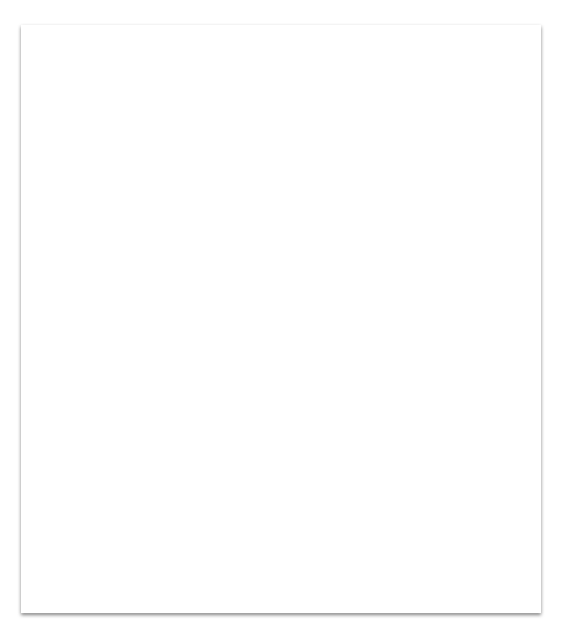
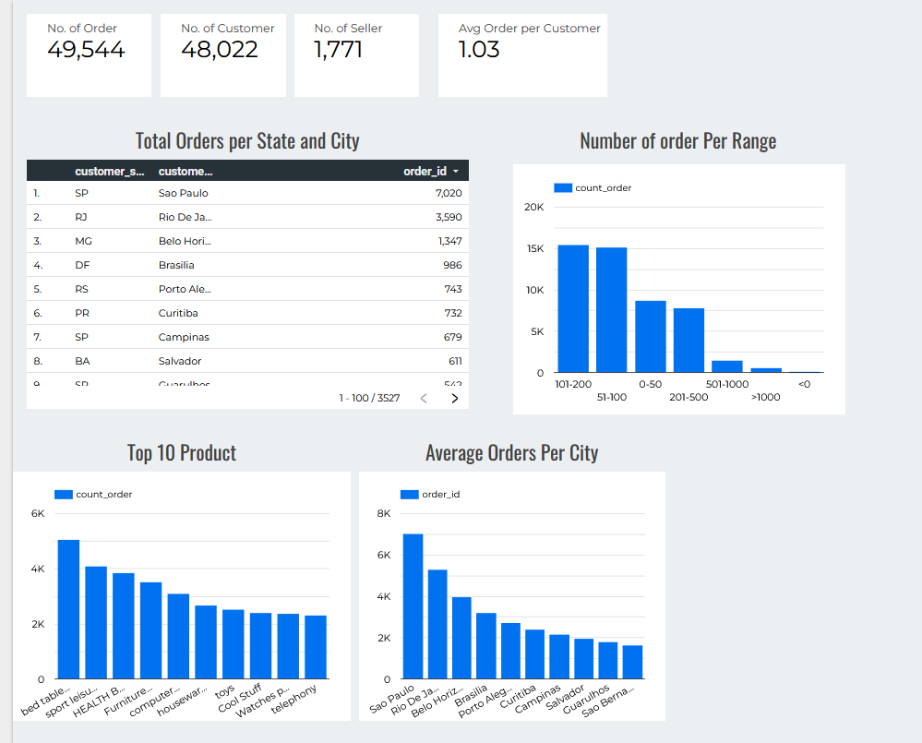
Now our company has 18,022 customer around brazil with 1,03 order rate per customer.
The most product bought is bed table in the first place and sport leisure in the second.

Slide 3
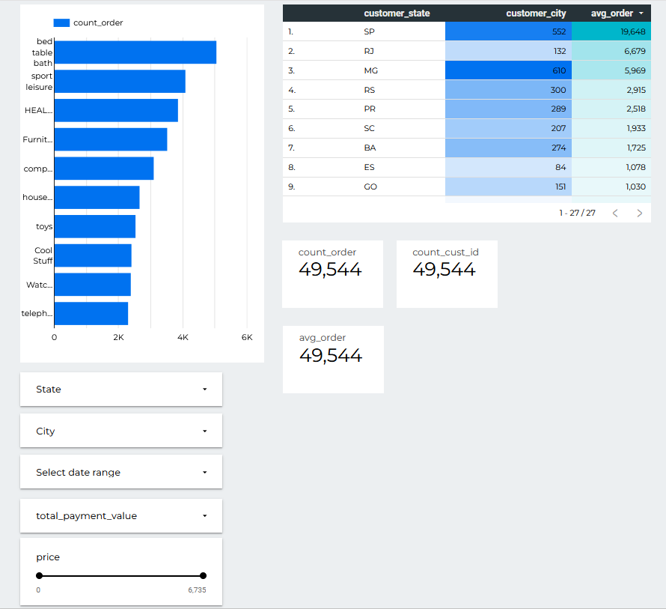
Looker
From the chart beside we can see Sao Paolo has the biggest number of order.
The most bought product is bed table.

Slide 4
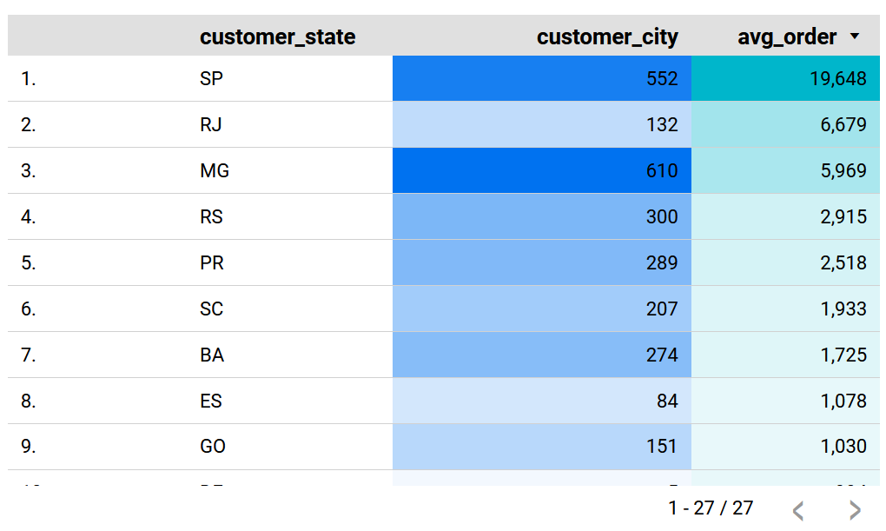
Sao Paolo has highest number of order with 19,648

Slide 5
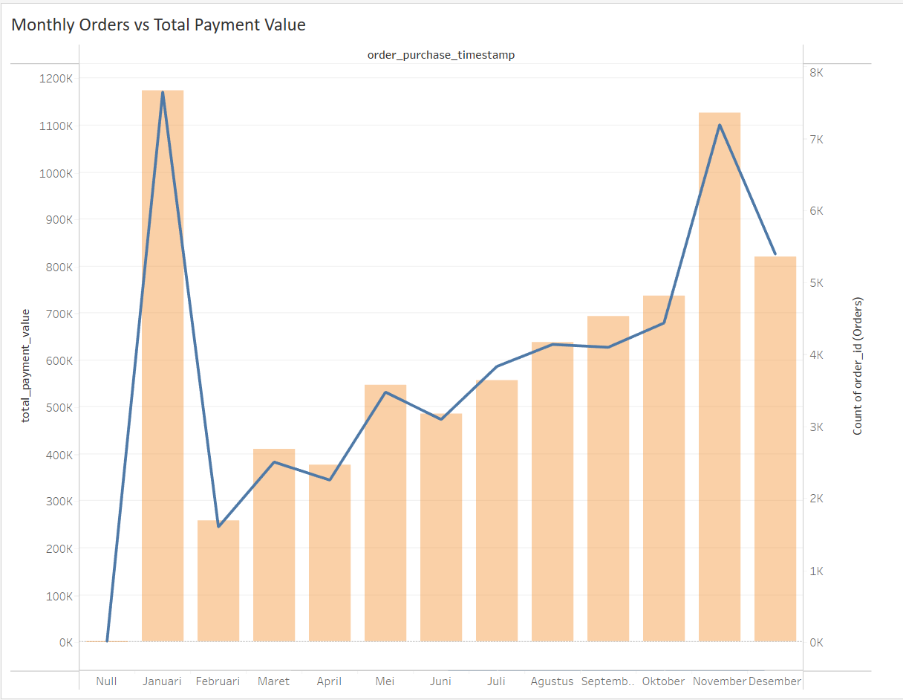
After analyzing Monthly order vs total payment value, we can find here that both are directly proportional. The order and total payment value will always together even though they are not in the exact position.

Slide 6

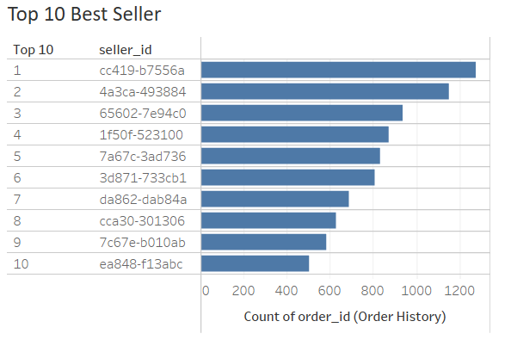
Those are the top 10 seller with the number 1 seller has completed up to 1200 orders.

Slide 7

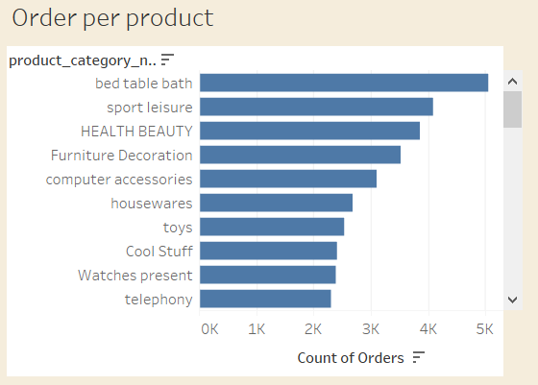
The chart beside shows the top 10 product category that have been the trend in Brazil.

Slide 8
Thank You

